Slide 1
Efficient forecasting and uncertainty quantification for large scale account level Monte Carlo models of debt recovery
Abhishek Thomas

Slide 2
INDEX
Challenges & solution
Results
Methods and Details
Representative model
Error analysis and optimal number of realisations
Uncertainty quantification
Protection of portfolio-level forecasts
Predicting the variance of independent accounts using Gaussian process emulators

Slide 3
Challenges & Solutions

Slide 4
Challenge
Have to predict probability of payment for each account for each month in next 7 years (84 points)
Have to use individual level forecast which is aggregated to make population level forecast on a biannual basis called forecasting rounds
Need to use monte Carlo simulation because there are lot of random factors
Using monte Carlo is expensive because there are millions of heterogenous accounts, even though model is simple logistic regression to find the probability of payment
Since there are so many accounts its outcomes are limited and the simulation will be too expensive to carry for all accounts, we don’t know how to use the limited amount of outcomes and if we are using it with how much certainty can we say
Solution
Creating an efficient monte carlo simulation to give only required outcomes or predictions by reducing variance
Uncertainty interval in the aggregated forecast
To implement the above 2 things we make gaussian process emulator for prediction interval and efficient carlo outcomes

Slide 5
Results

Slide 6
Representative model

Slide 7
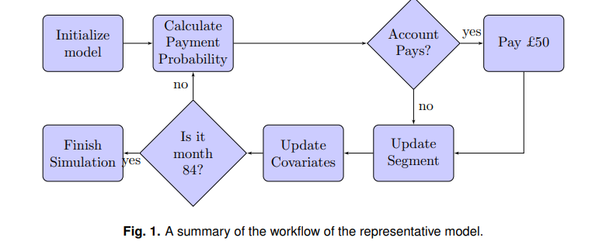
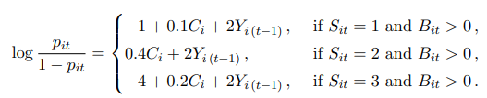

Population
Accounts has accumulated over more than a decade and is composed of a wide variety of products, from loans, overdrafts, and credit cards to mail order credit, telecommunication debt, and student loans. As such the portfolio is highly heterogeneous, and the model is complex.
Representative model used to simplify the AGL model and shares the main characteristics of AGL’s model.
Model Parameters
Uses logistic regression time series to give output Pit which is probability of payment for next month using inputs of previous month. The inputs are
Xit(collection amount), the amount paid by the customer
Yit(Payment indicator), 1 or 0
Zit(Covariates(Bit, Cit, Sit, Eit))
Bit, balance amount
Cit, credit score
Sit, operational segment
Eit, eligibility indicator
Where
i ranges from 1 to N,
t ranges from 1 to 12*7= 84 months

Slide 8
Methodology
the covariate values for N accounts are initialized via simulation from appropriate distributions to give heterogeneous behaviour similar to that observed in AGL’s commerical model
Si1 can be put into 1(20%), 2(20%) or 3(60%) segement . Where
1, mostly likely to pay
2, can pay
3, very difficult to pay amount
Segment transition
Accounts can transition between if the meet the criterias
the account is eligible for transition;
the account is in Segment 3;
the account did not make a payment in the preceding month.
Eit Eligibility is decided according to a time-independent indicator covariate Ei which is initialized according to Ei ∼ Bernoulli(0.1).
Segment transition is also dependent on other payment pattern of other accounts
Macroeconomic is also a factor commonly, but not in scope of this paper

Slide 9


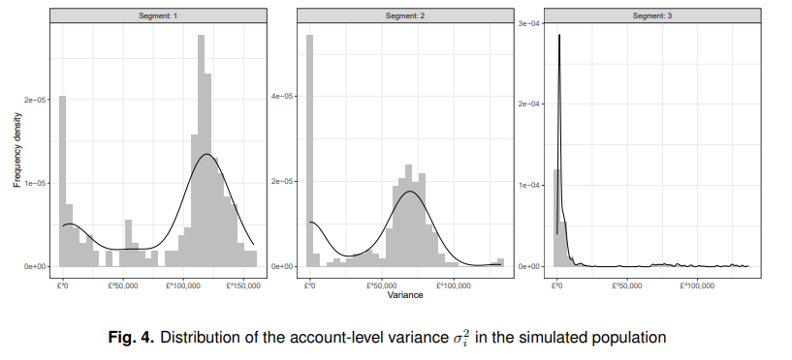
Estimation of expected collection
Difference between representative and commercial model
Aspect | Paper's Model | Arrow's Commercial Model
Model Complexity | Simplified for clarity and explanation | More complex and tailored to real-world needs
Data Inputs | Basic data like credit score, payment history, balance | Detailed data, including demographics and external credit reports
Segments and Transitions | Simple segment rules with predefined probabilities | Sophisticated segments and dynamic rules
Payment Probability | Logistic regression | Advanced machine learning techniques
Payment Amount | Assumes fixed or simple proportional payments | Detailed rules for determining payment amounts
Simulation Efficiency | Focuses on improving computational efficiency | Efficient but uses proprietary methods
Uncertainty Quantification | Develops prediction intervals to measure uncertainty | Uses additional methods like scenario analysis
Integration with Operations | Demonstrates theoretical concepts | Fully integrated into day-to-day operations
Data Granularity | Uses monthly data and biannual updates | More frequent updates (e.g., weekly or daily)
We can get average by summing collection amount and the R (no of probability of payments) all accounts
We can see expected collection distribution of various the segments below

Slide 10
Error analysis and optimal number of realisations

Slide 11
The accounts which need to be selected should be having high variance as they contribute more
Accounts with high variance in covariates should be picked from each segment for the monte carlo simulation

Slide 12
Uncertainty quantification

Slide 13
Protection of portfolio-level forecasts

Slide 14
Predicting the variance of independent accounts using Gaussian process emulators

